Slide 1


Vietnam National University HCMC
International University School of Electrical Engineering
IOT-BASED APPLICATIONS FOR WATER
RESOURCE MONITORING SYSTEM
Present by: NGUYEN TRUNG TIN
ID: EEACIU19063
Advisor: Dr. VUONG QUOC BAO

Slide 2
CONTENTS
I. Introduction
Project Management
Literature Review
Methodology
Results
Conclusion and Future Work
References

Slide 3
I. Introduction
1. The goal and Objectives
Design and development of a water quality monitoring system that uses sensors and a microcontroller to measure key parameters such as temperature, pH, turbidity, water level, water flow, TDS and GPS. Then send and display the data on mobile app.
To achieve the goal, the objectives include the following:
Objective 1: Review the existing techniques that use IoT to monitor water quality.
Objective 2: Design and implement an IoT-based system to measure water quality parameters.
Objective 3: Evaluate the system performance in different environments.

Slide 4
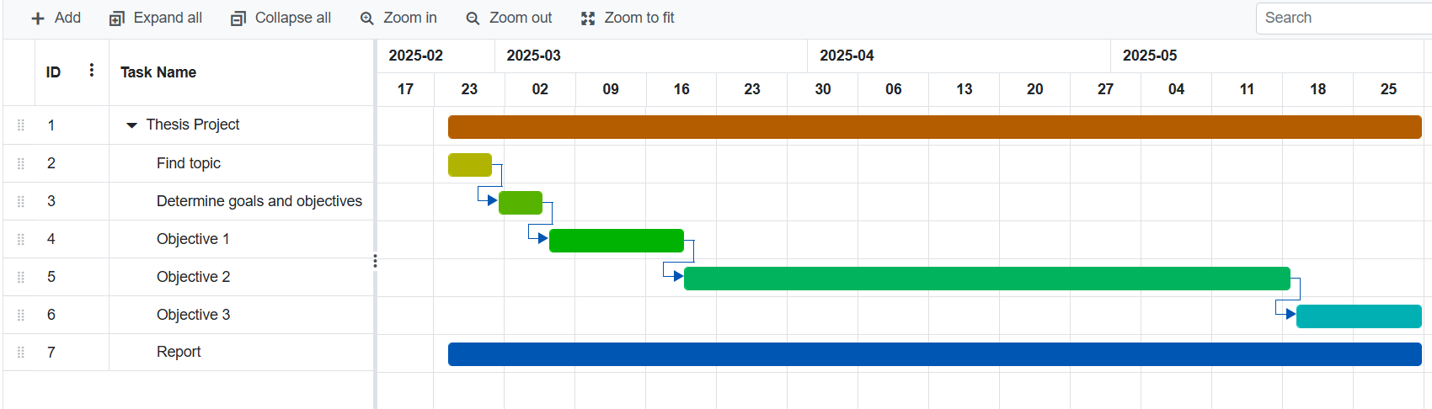
II. Project Management
Figure 2.1 Gantt chart

Slide 5
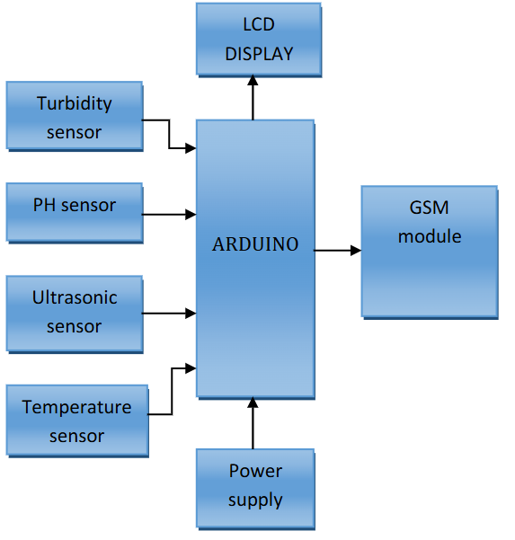
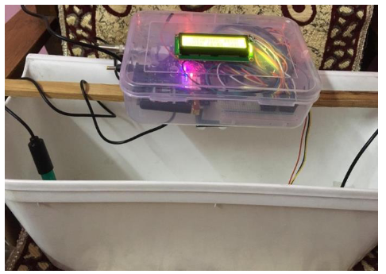
III. Literature Review
1. Design and Implementation of a Smart Water Monitoring System…[3]
This paper presents a low-cost IoT-based solution for real-time water quality monitoring.
Uses sensors to measure pH, turbidity and temperature parameters.(Objective 1)
Figure 3.1 Block diagram [3]
Figure 3.2 Prototype of product [3]

Slide 6
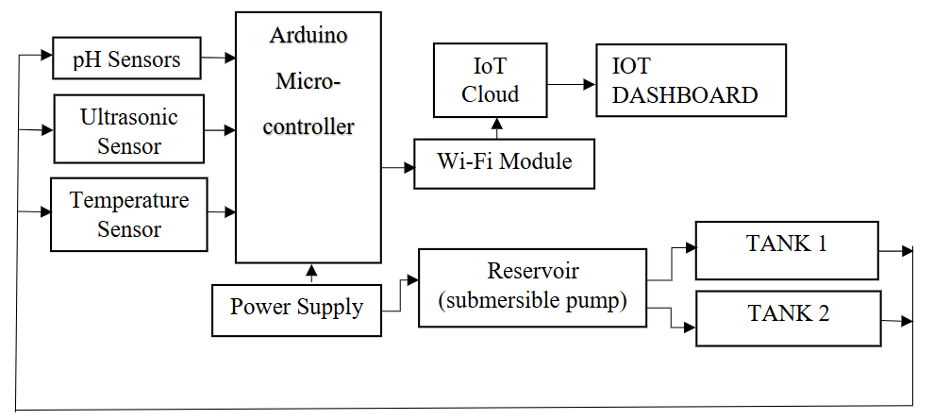
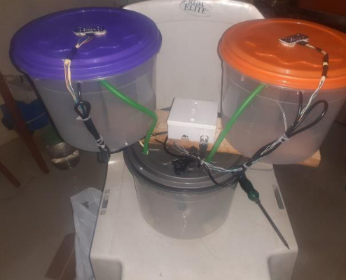
III. Literature Review
2. Design and Implementation of a Smart Water Monitoring System…[4]
Figure 3.3 Block diagram of the project [3]
Figure 3.4 Image of the final project work [3]
This study presents a smart water monitoring system using IoT technology, focusing on real-time measurement of water quality and level (Objective 1)

Slide 7
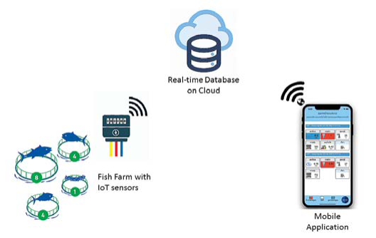
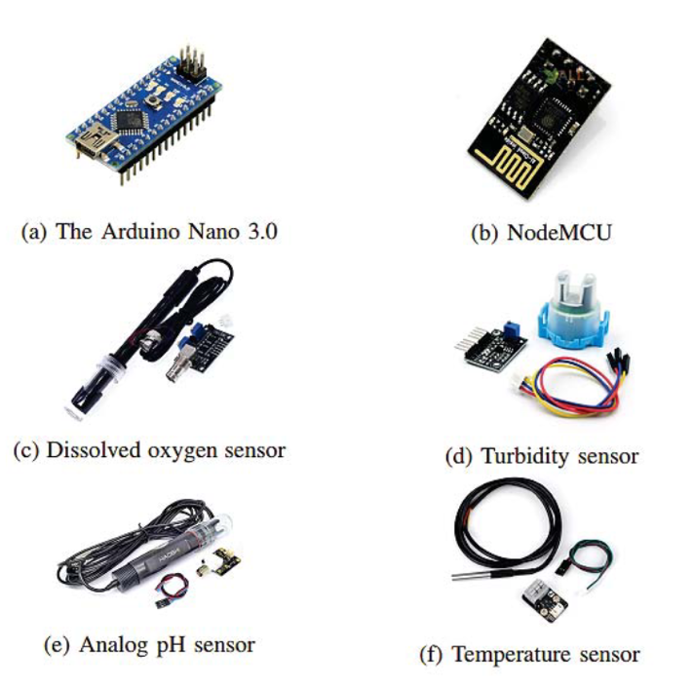
III. Literature Review
3. Real-time Water Quality Monitoring and Notification System… [5]
Figure 3.5 Image of the project [5]
The main purpose of the research is to develop a smart farm model using IoT to raise fish at high density in a closed system to be environmentally friendly and sustainable. (Objective 2)

Slide 8
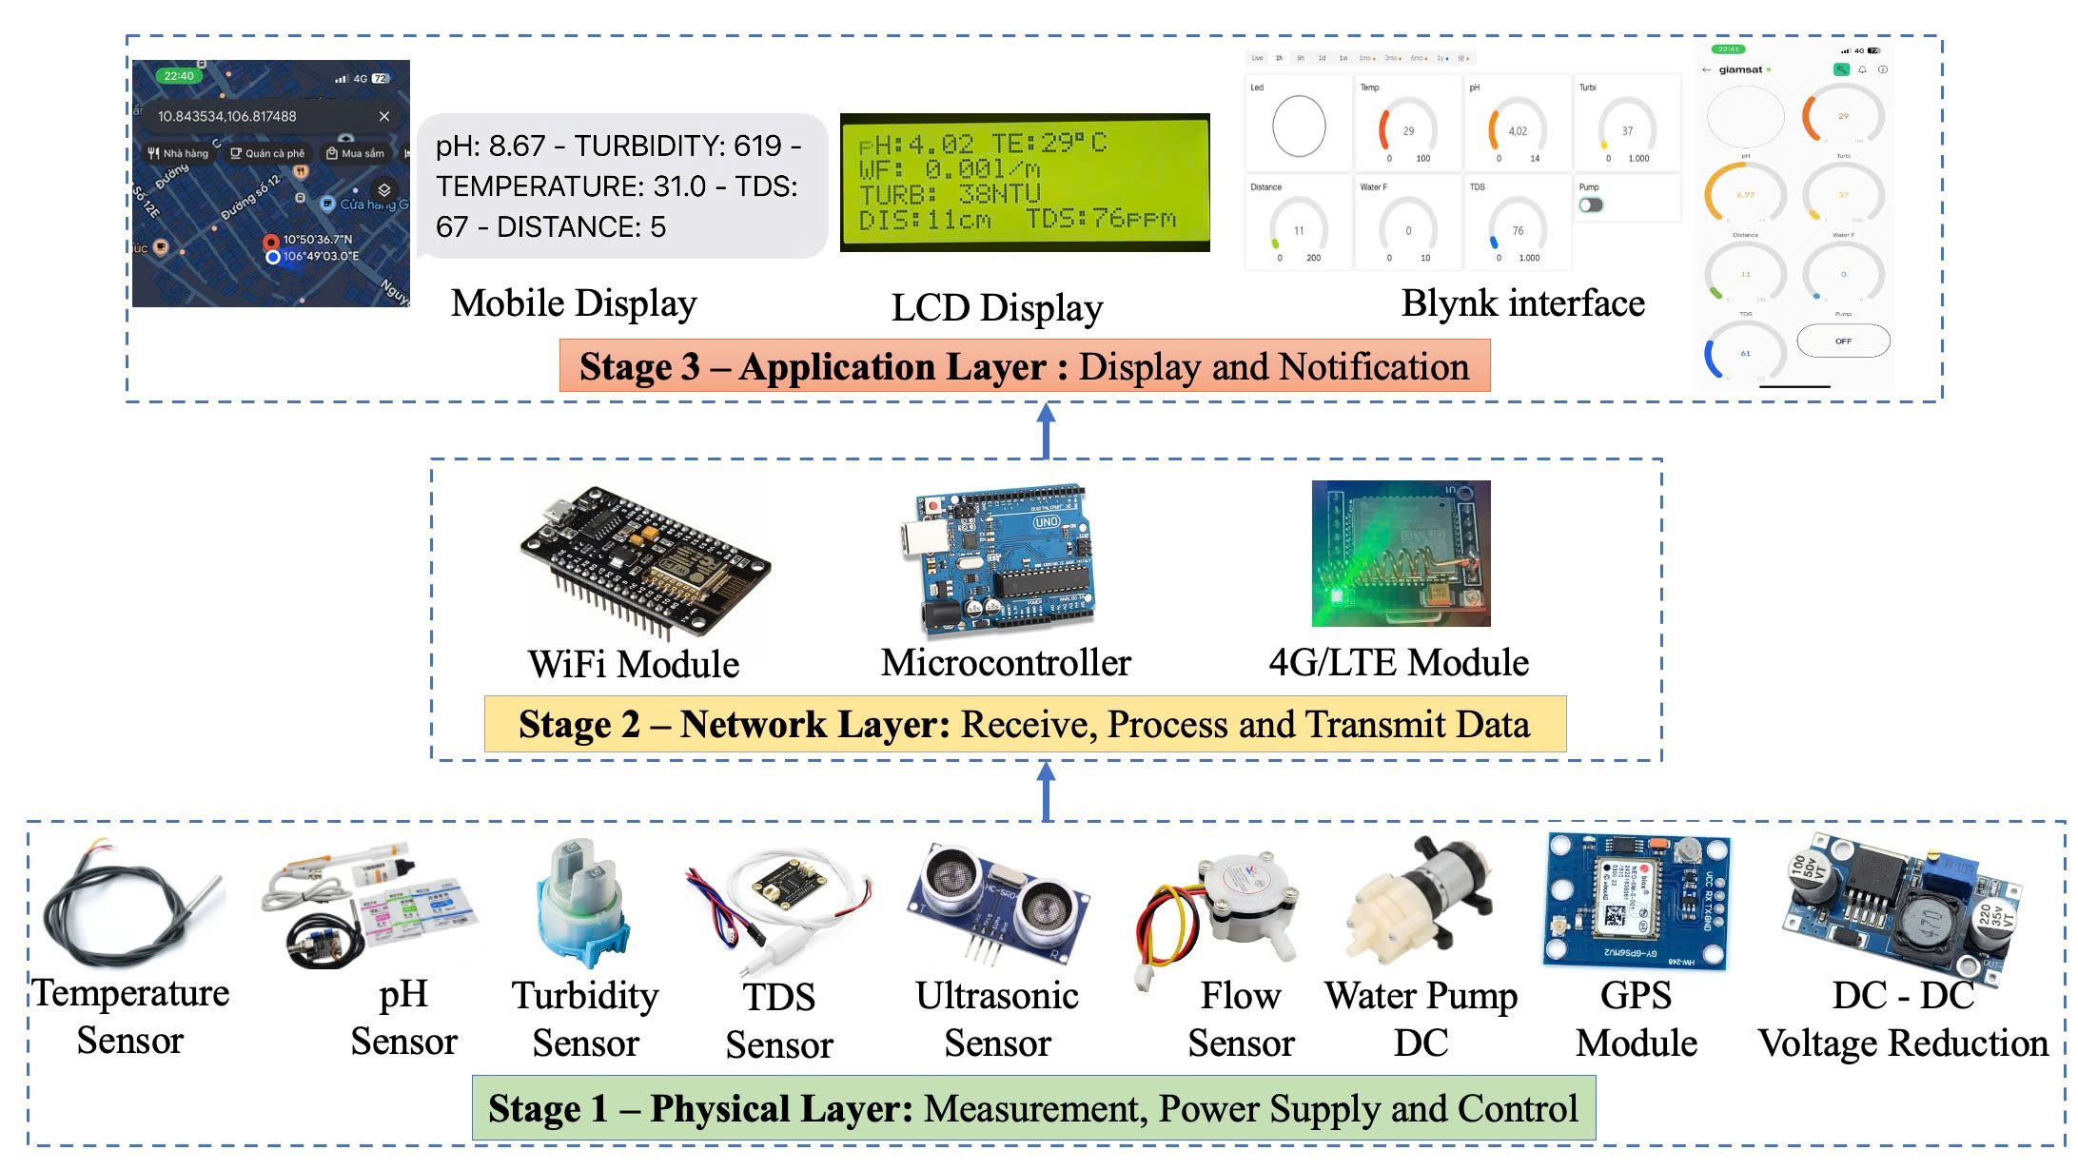
IV. Methodology
1. Proposed methodology for this thesis project
Figure 4.1 Entire system
Notes:
f

Slide 9
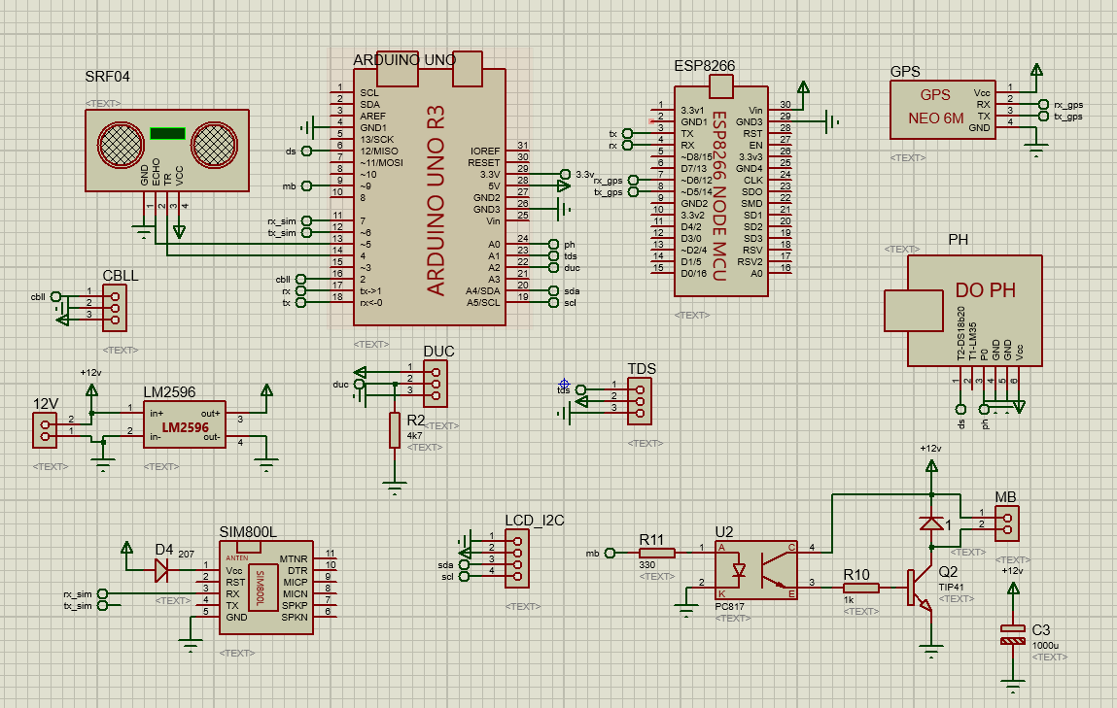
IV. Methodology
IV. Methodology
2. Drawing the schematic.
Figure 4.2 Schematic of the system.

Slide 10
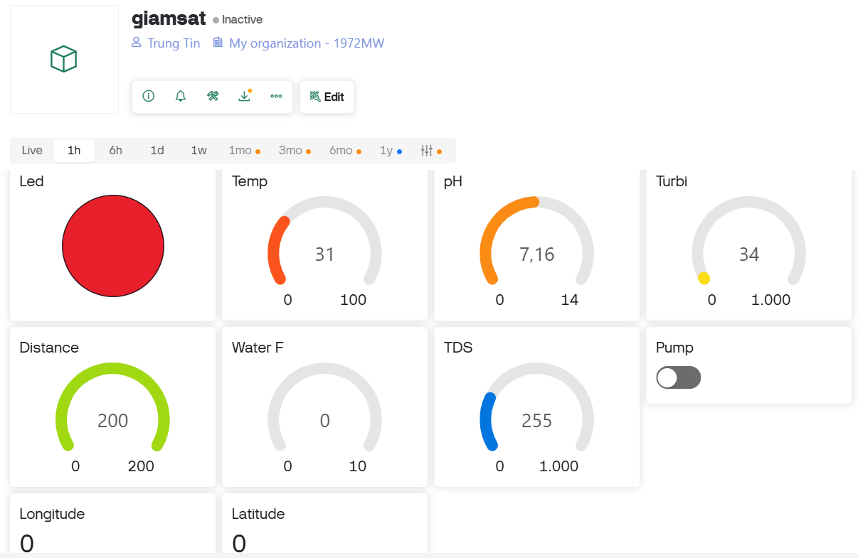
IV. Methodology
2. Blynk app
LED warning
Temperature
pH levels
Turbidity (water clarity)
Water level
Water flow
Total dissolved solids (TDS)
Pump
Longitude
Latitude
Figure 4.3 Blynk application interface on smartphone.
Notes:
f

Slide 11
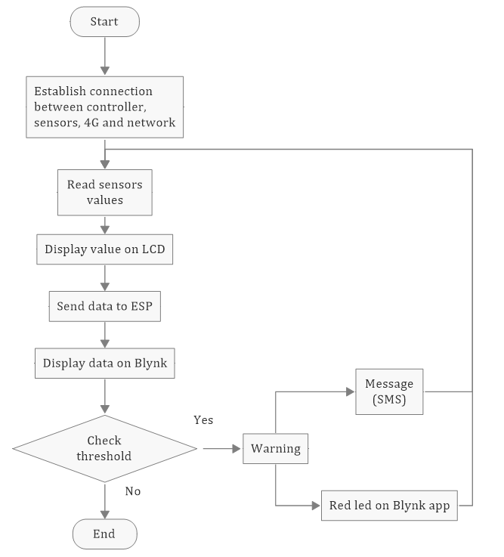
IV. Methodology
2. Software design
2.3 Programming
Figure 4.4 The Flowchart of IoT Water Monitoring System

Slide 12
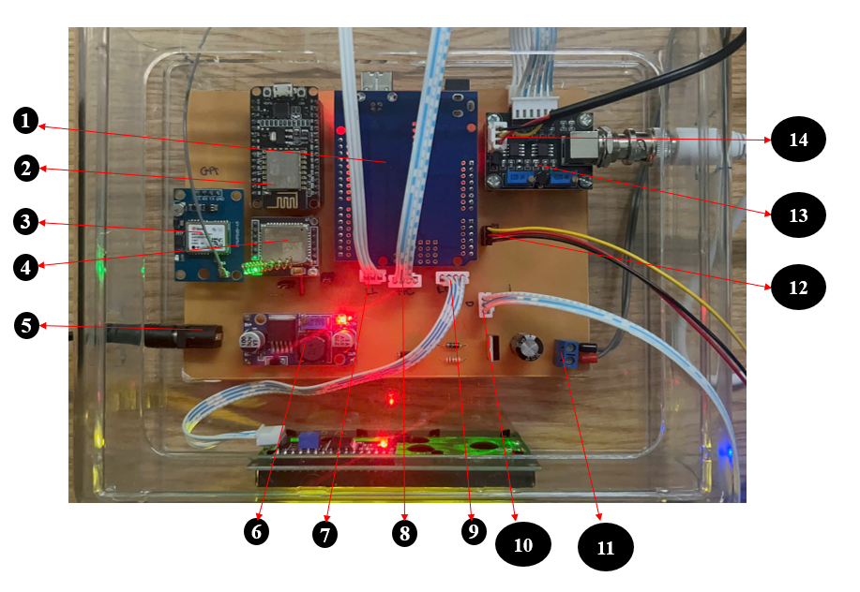
V. Results
1. Hardware design
Arduino UNO R3
Wifi module
GPS module
4G module (A7862S)
Power jack
DC-DC converter (LM2596)
Flow sensor
Ultrasonic sensor (HC-SRF04)
LCD display
Turbidity sensor
Pump
TDS sensor
pH sensor
Temperature sensor (DS18B20)
Figure 5.1 Hardware Design

Slide 13
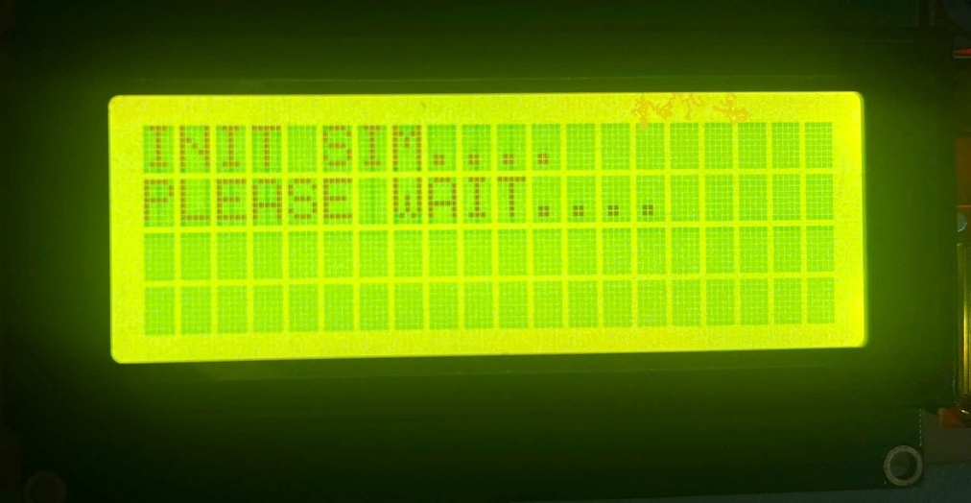
V. Results
2. Software design.
2.1 System boot.
Figure 5.2 LCD display.

Slide 14
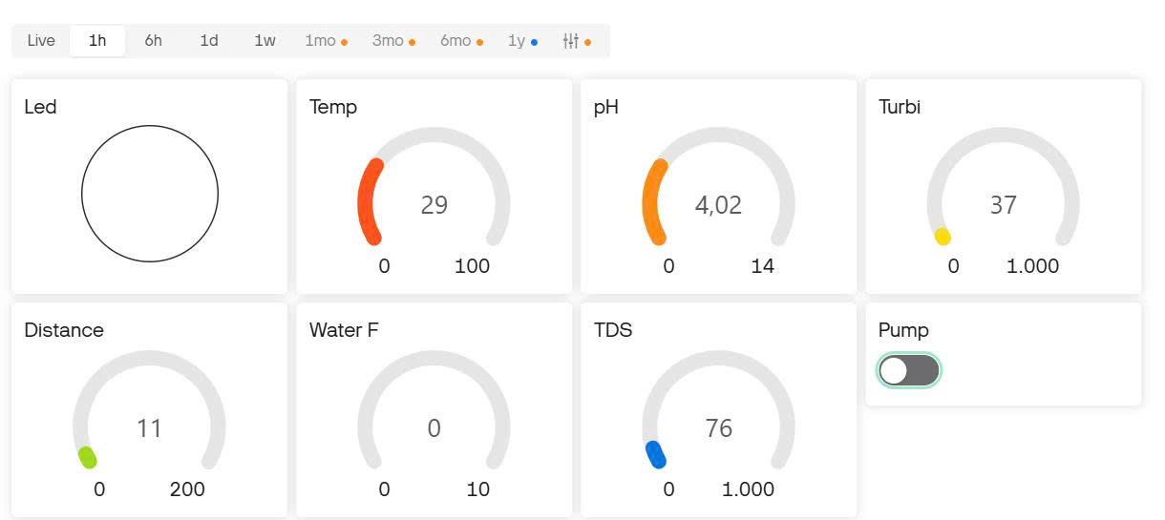
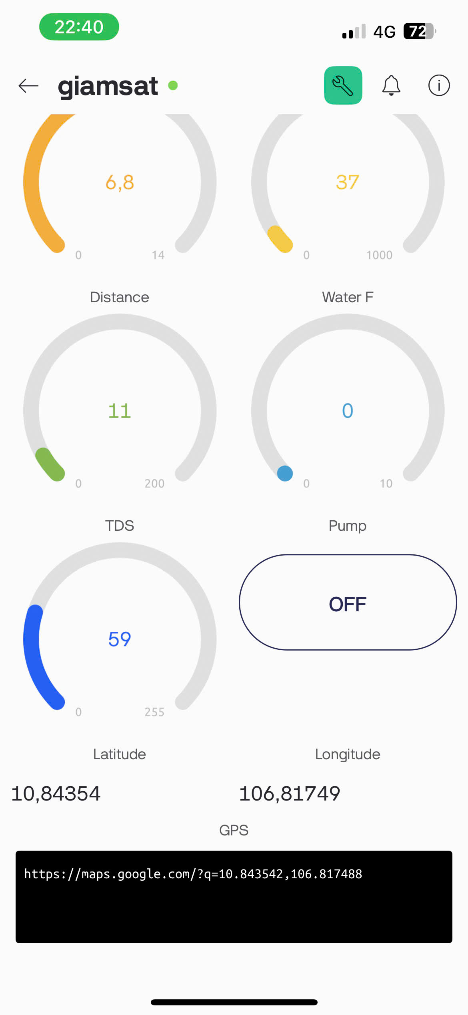
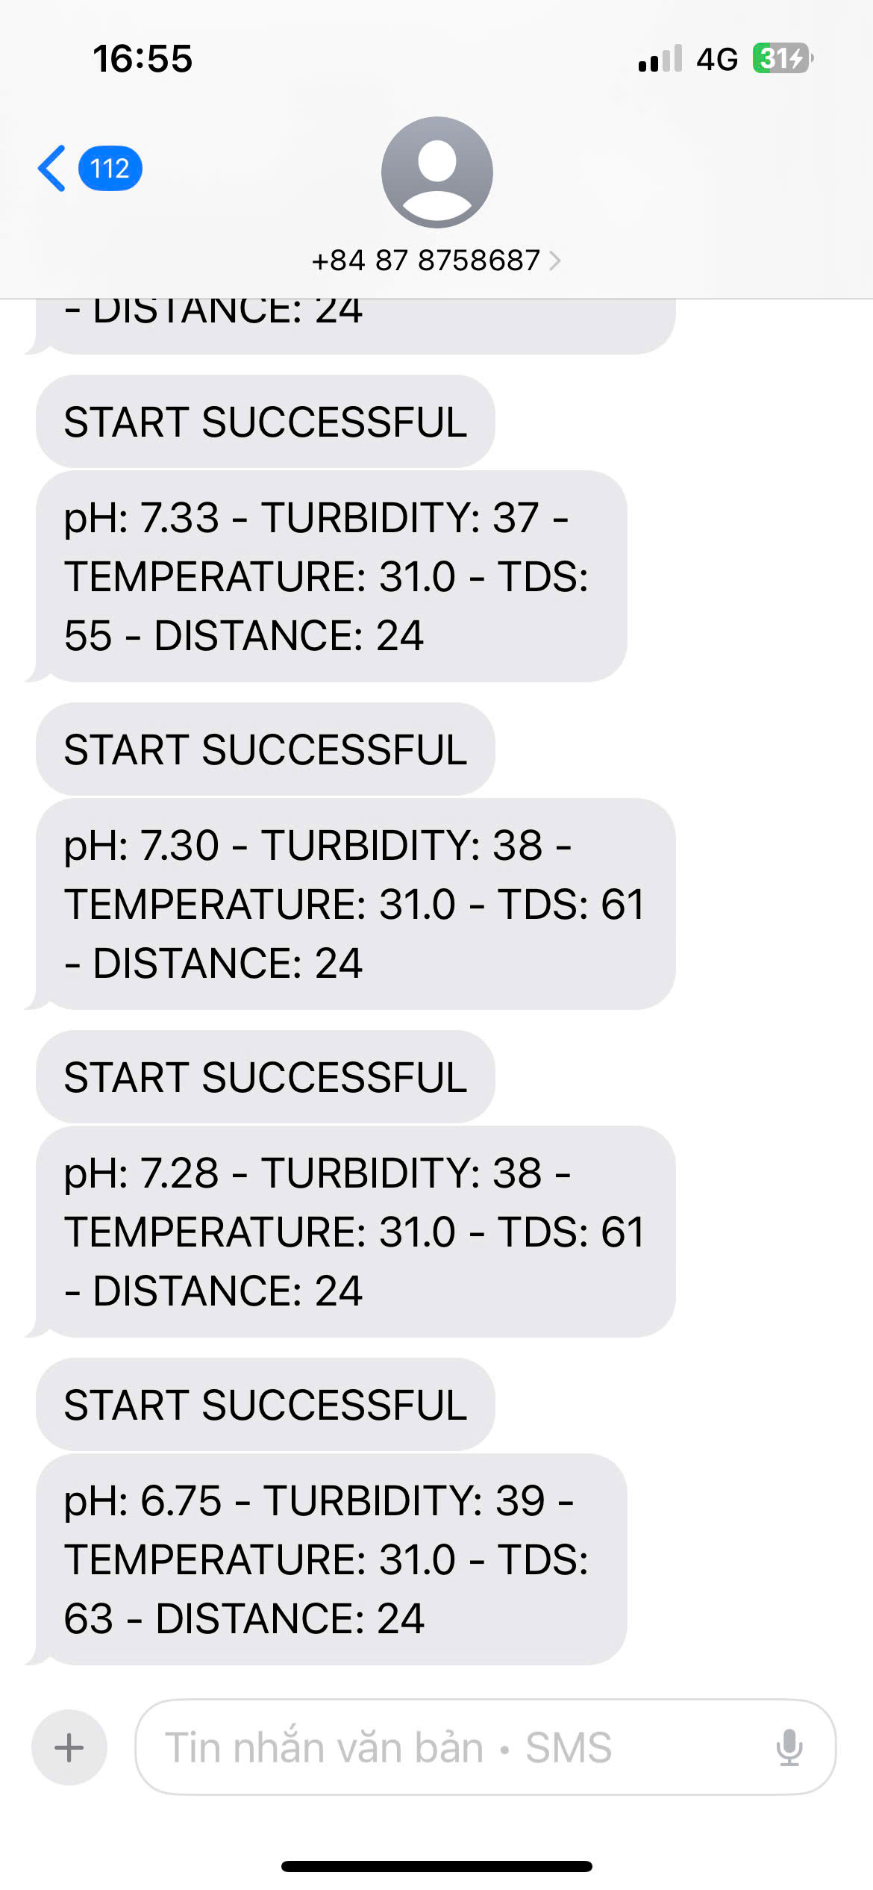
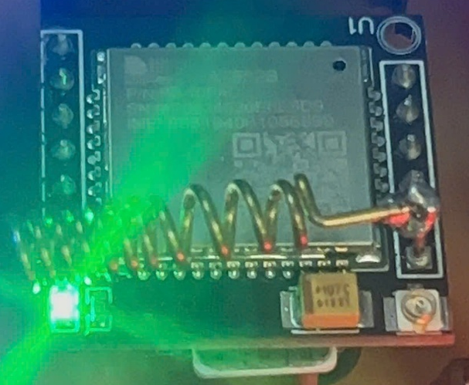
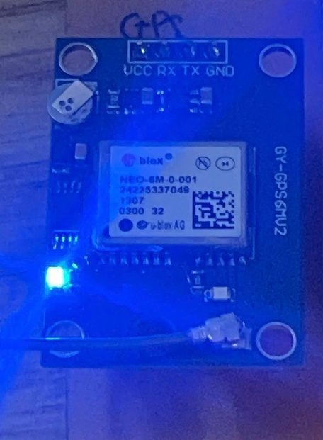
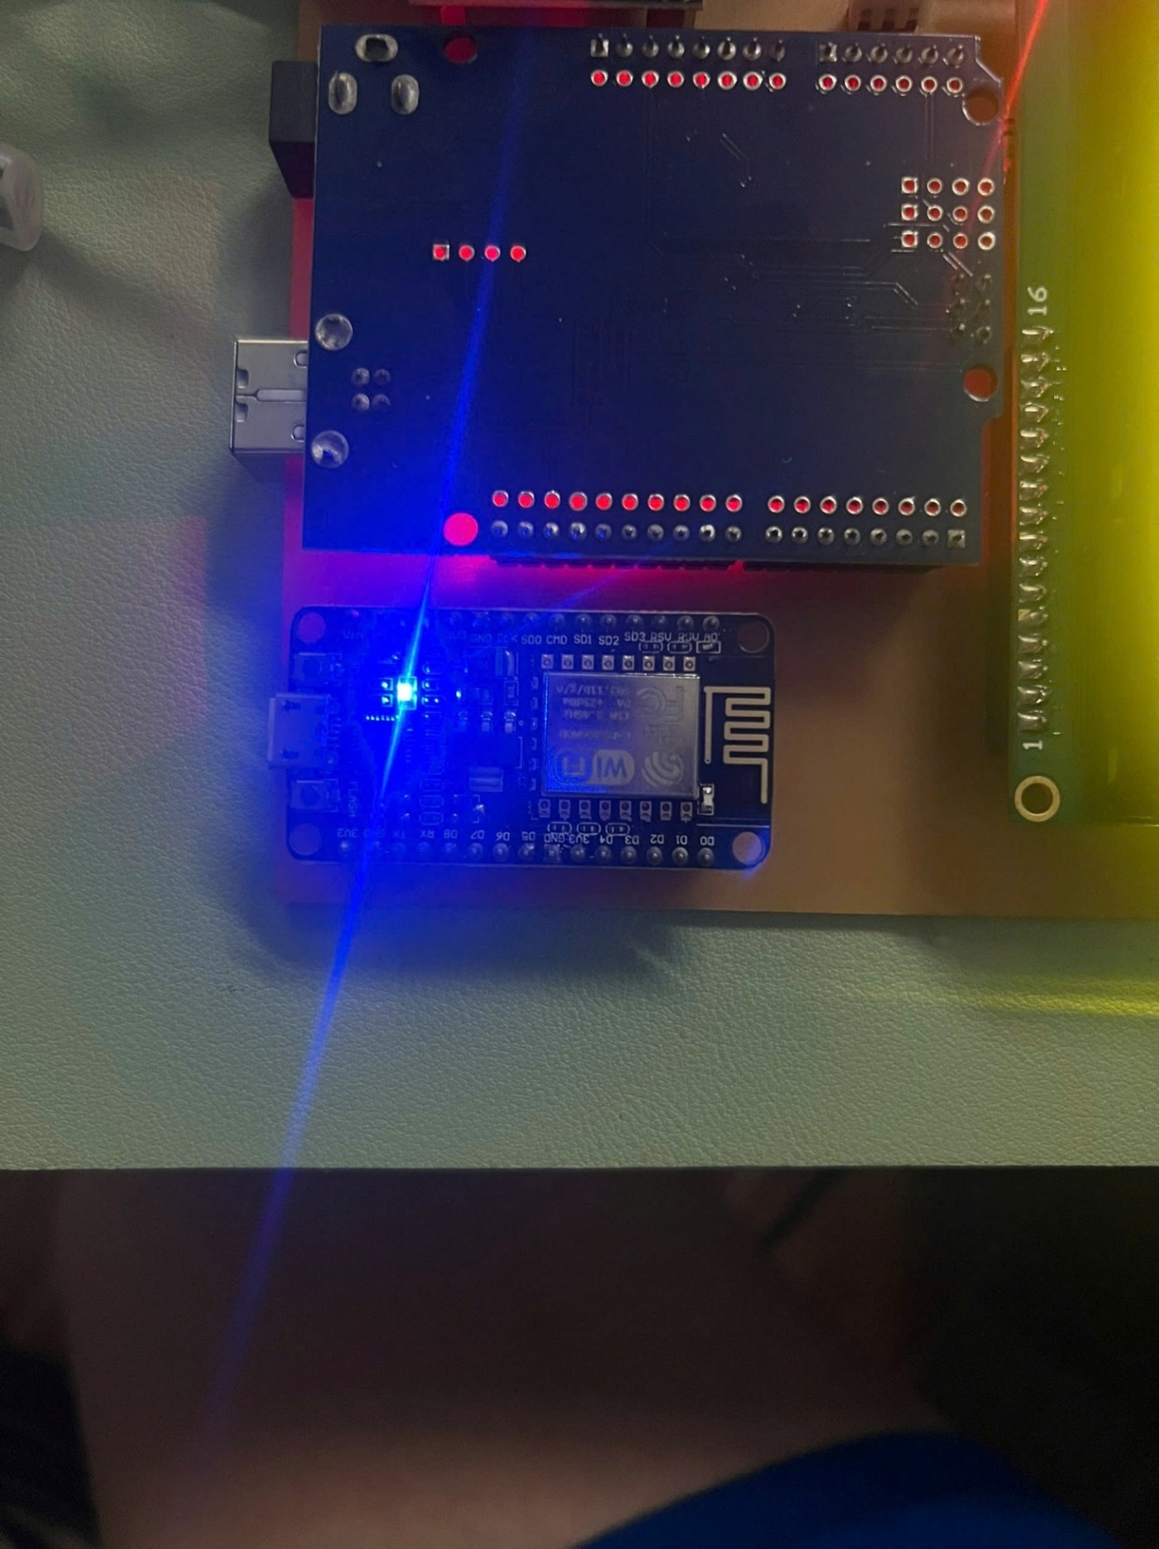
V. Results
2. Software design
2.2 System boot.
Figure 5.3 SIM connection successfully
Figure 5.4 ESP8266 connection successfully
Figure 5.5 GPS connection successfully

Slide 15
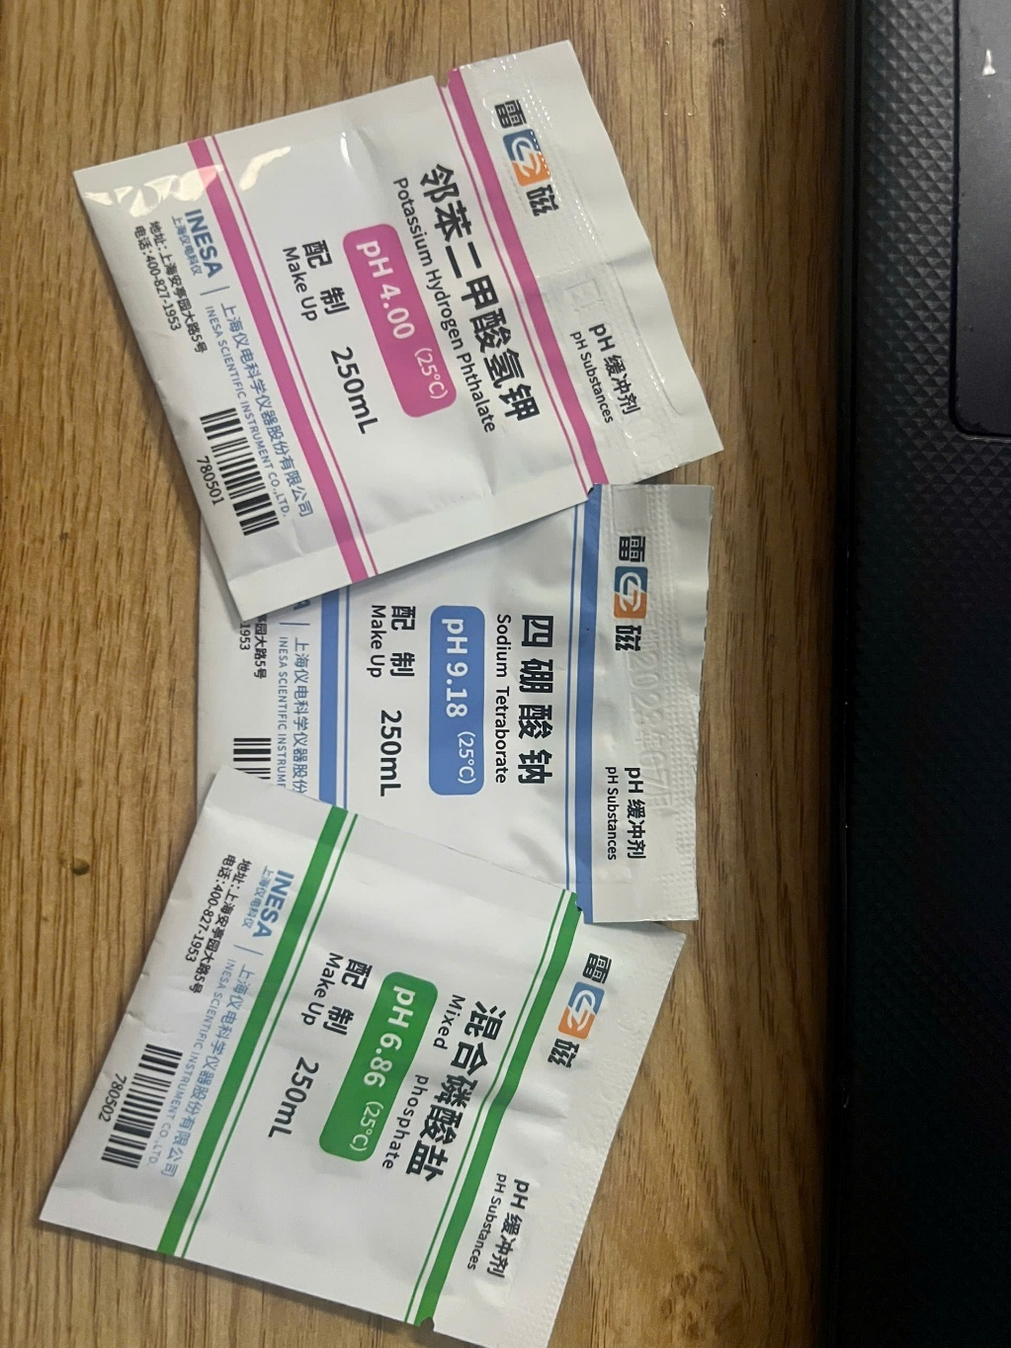
V. Results
3. Evaluate the system performance in different environments.
ºC | pH4.01 | pH6.86 | pH9.18
10 | 4.00 | 6.92 | 9.33
15 | 4.00 | 6.90 | 9.28
20 | 4.00 | 6.88 | 9.23
25 | 4.01 | 6.86 | 9.18
30 | 4.01 | 6.85 | 9.14
35 | 4.02 | 6.84 | 9.10
40 | 4.03 | 6.84 | 9.07
45 | 4.04 | 6.83 | 9.04
50 | 4.06 | 6.83 | 9.02
Figure 5.6 pH correction package.
Figure 5.7 pH correction package specifications.

Slide 16
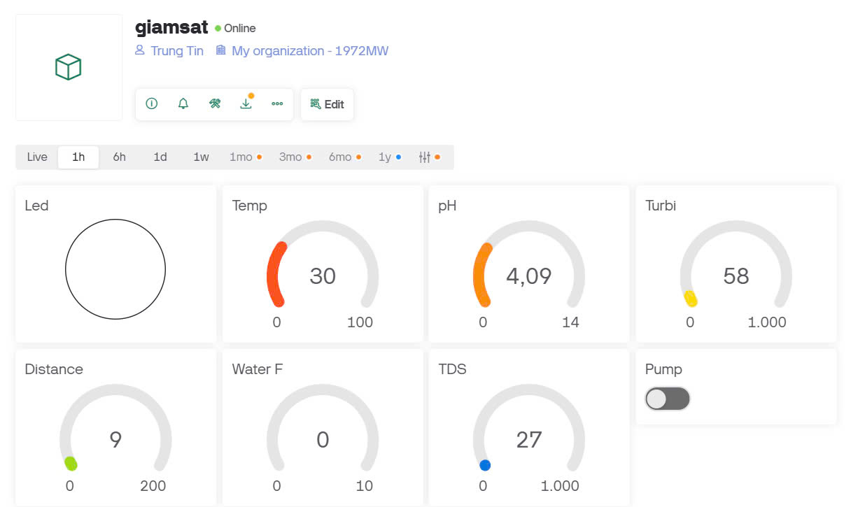
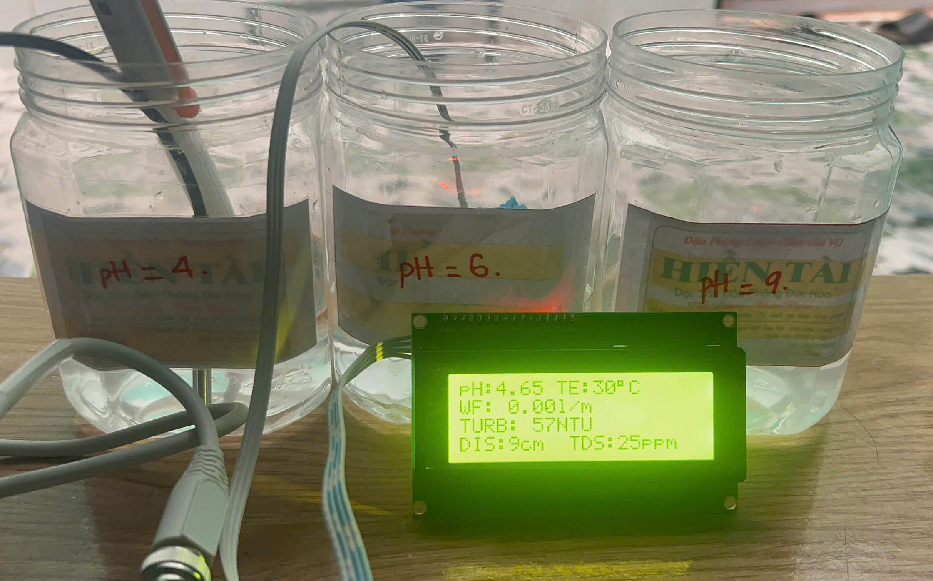
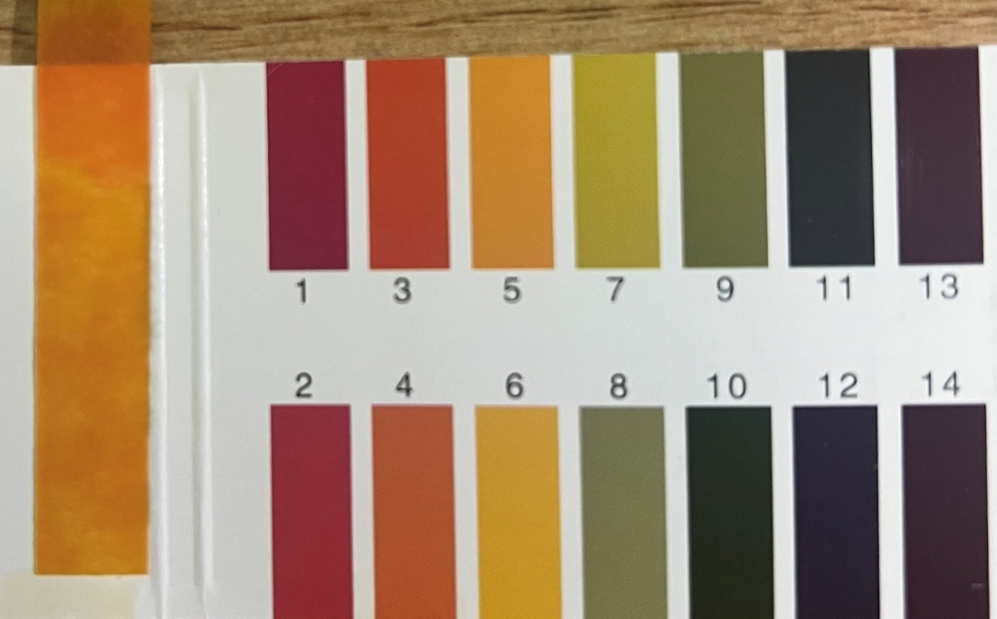
V. Results
3. Evaluate the system performance in different environments.
3.1 Case 1: Acidic environment: pH about 4.
Figure 5.10 The litmus.
Figure 5.8 Hardware.
Figure 5.9 Blynk.

Slide 17
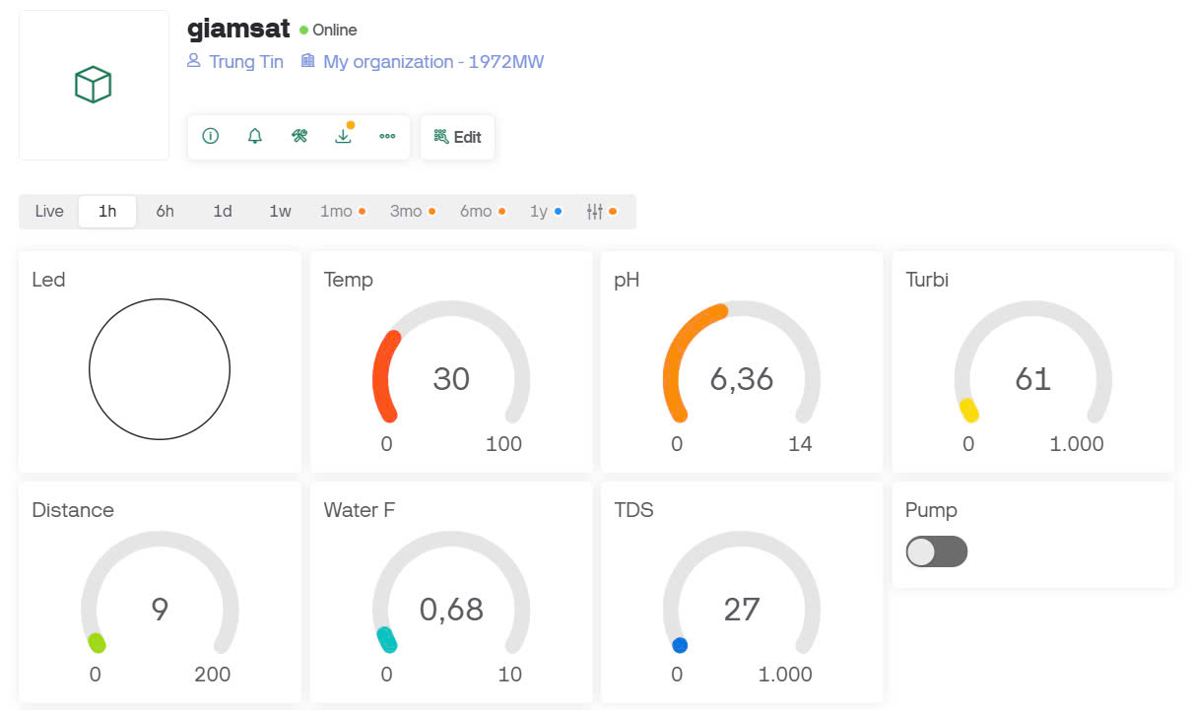
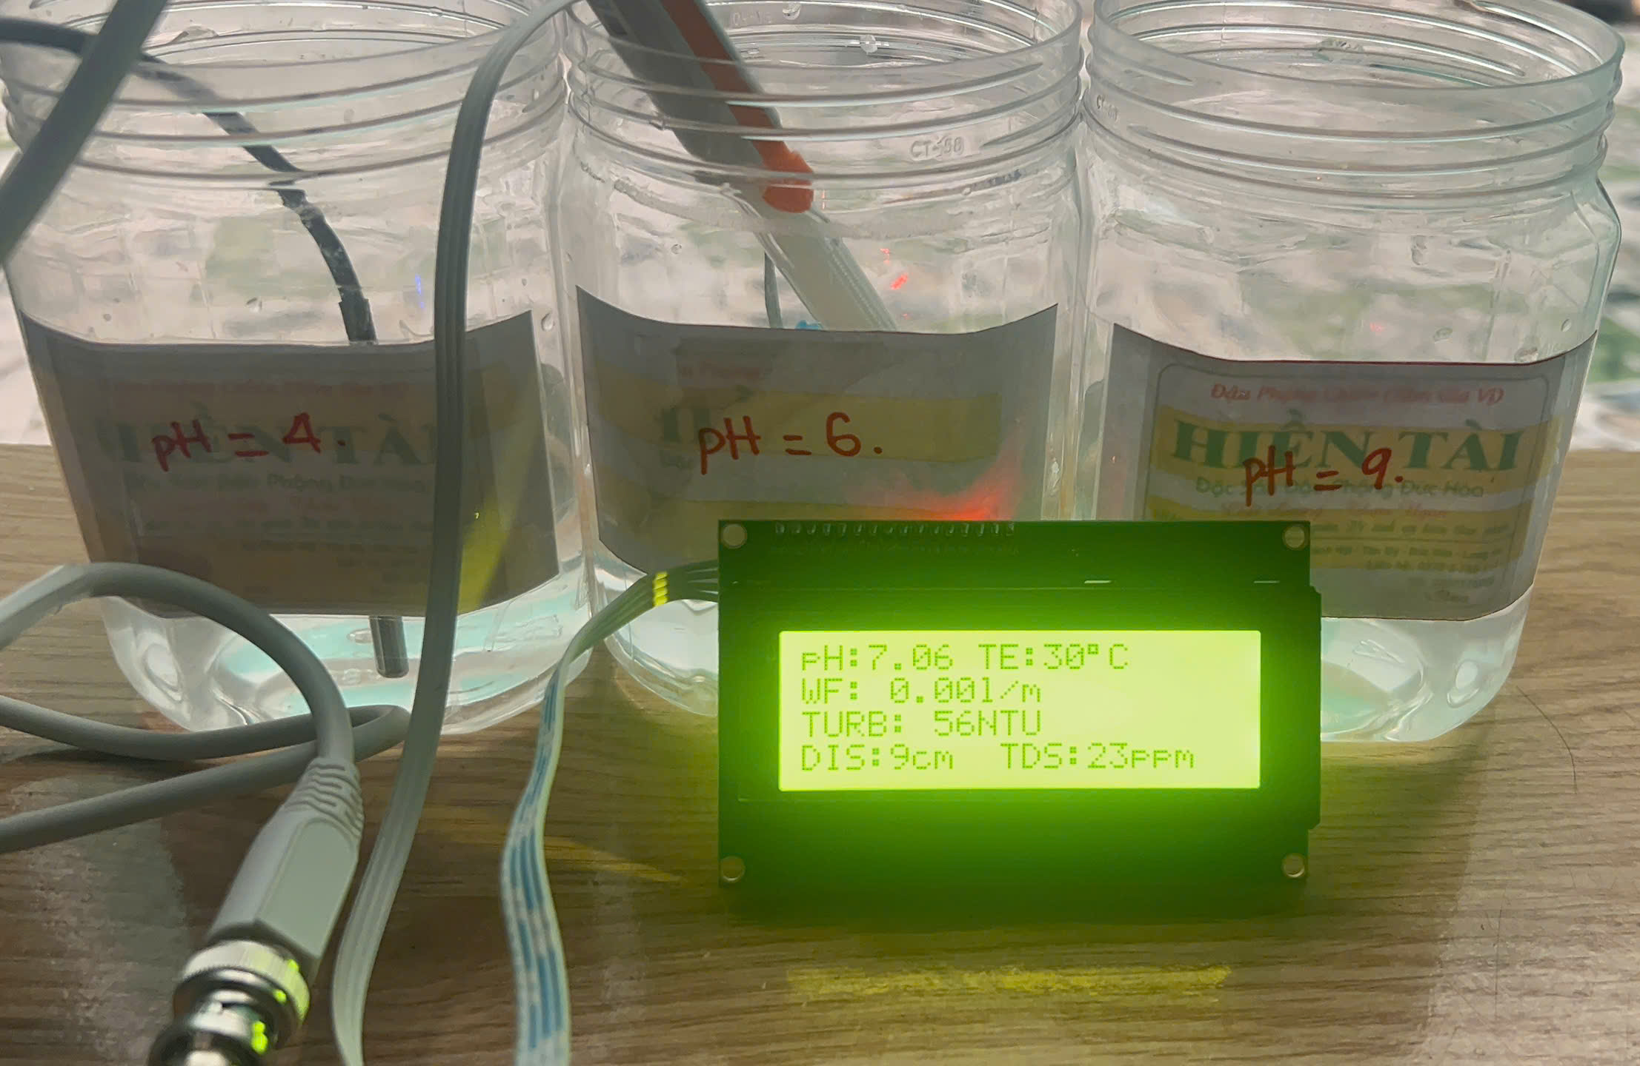
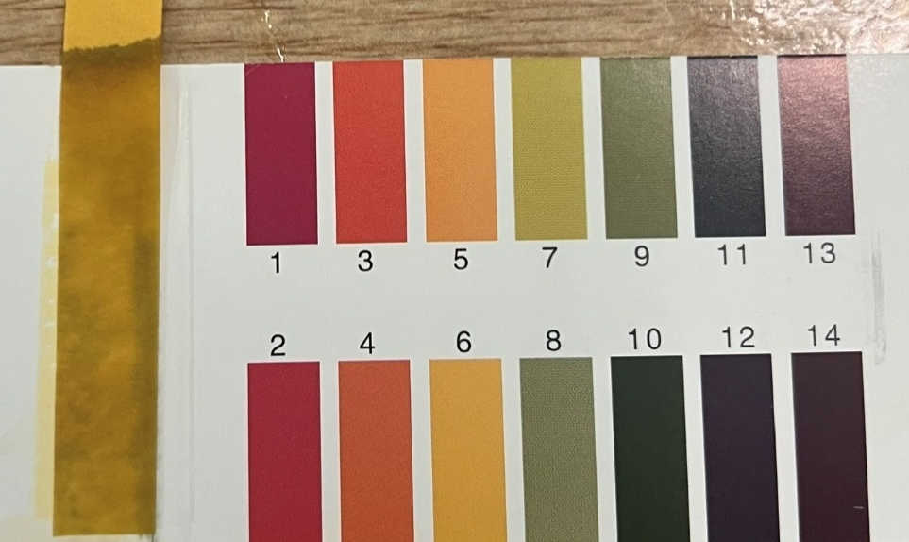
V. Results
3. Evaluate the system performance in different environments.
3.2 Case 2: Neutral environment: pH about 6
Figure 5.13 The litmus.
Figure 5.11 Hardware.
Figure 5.12 Blynk.

Slide 18
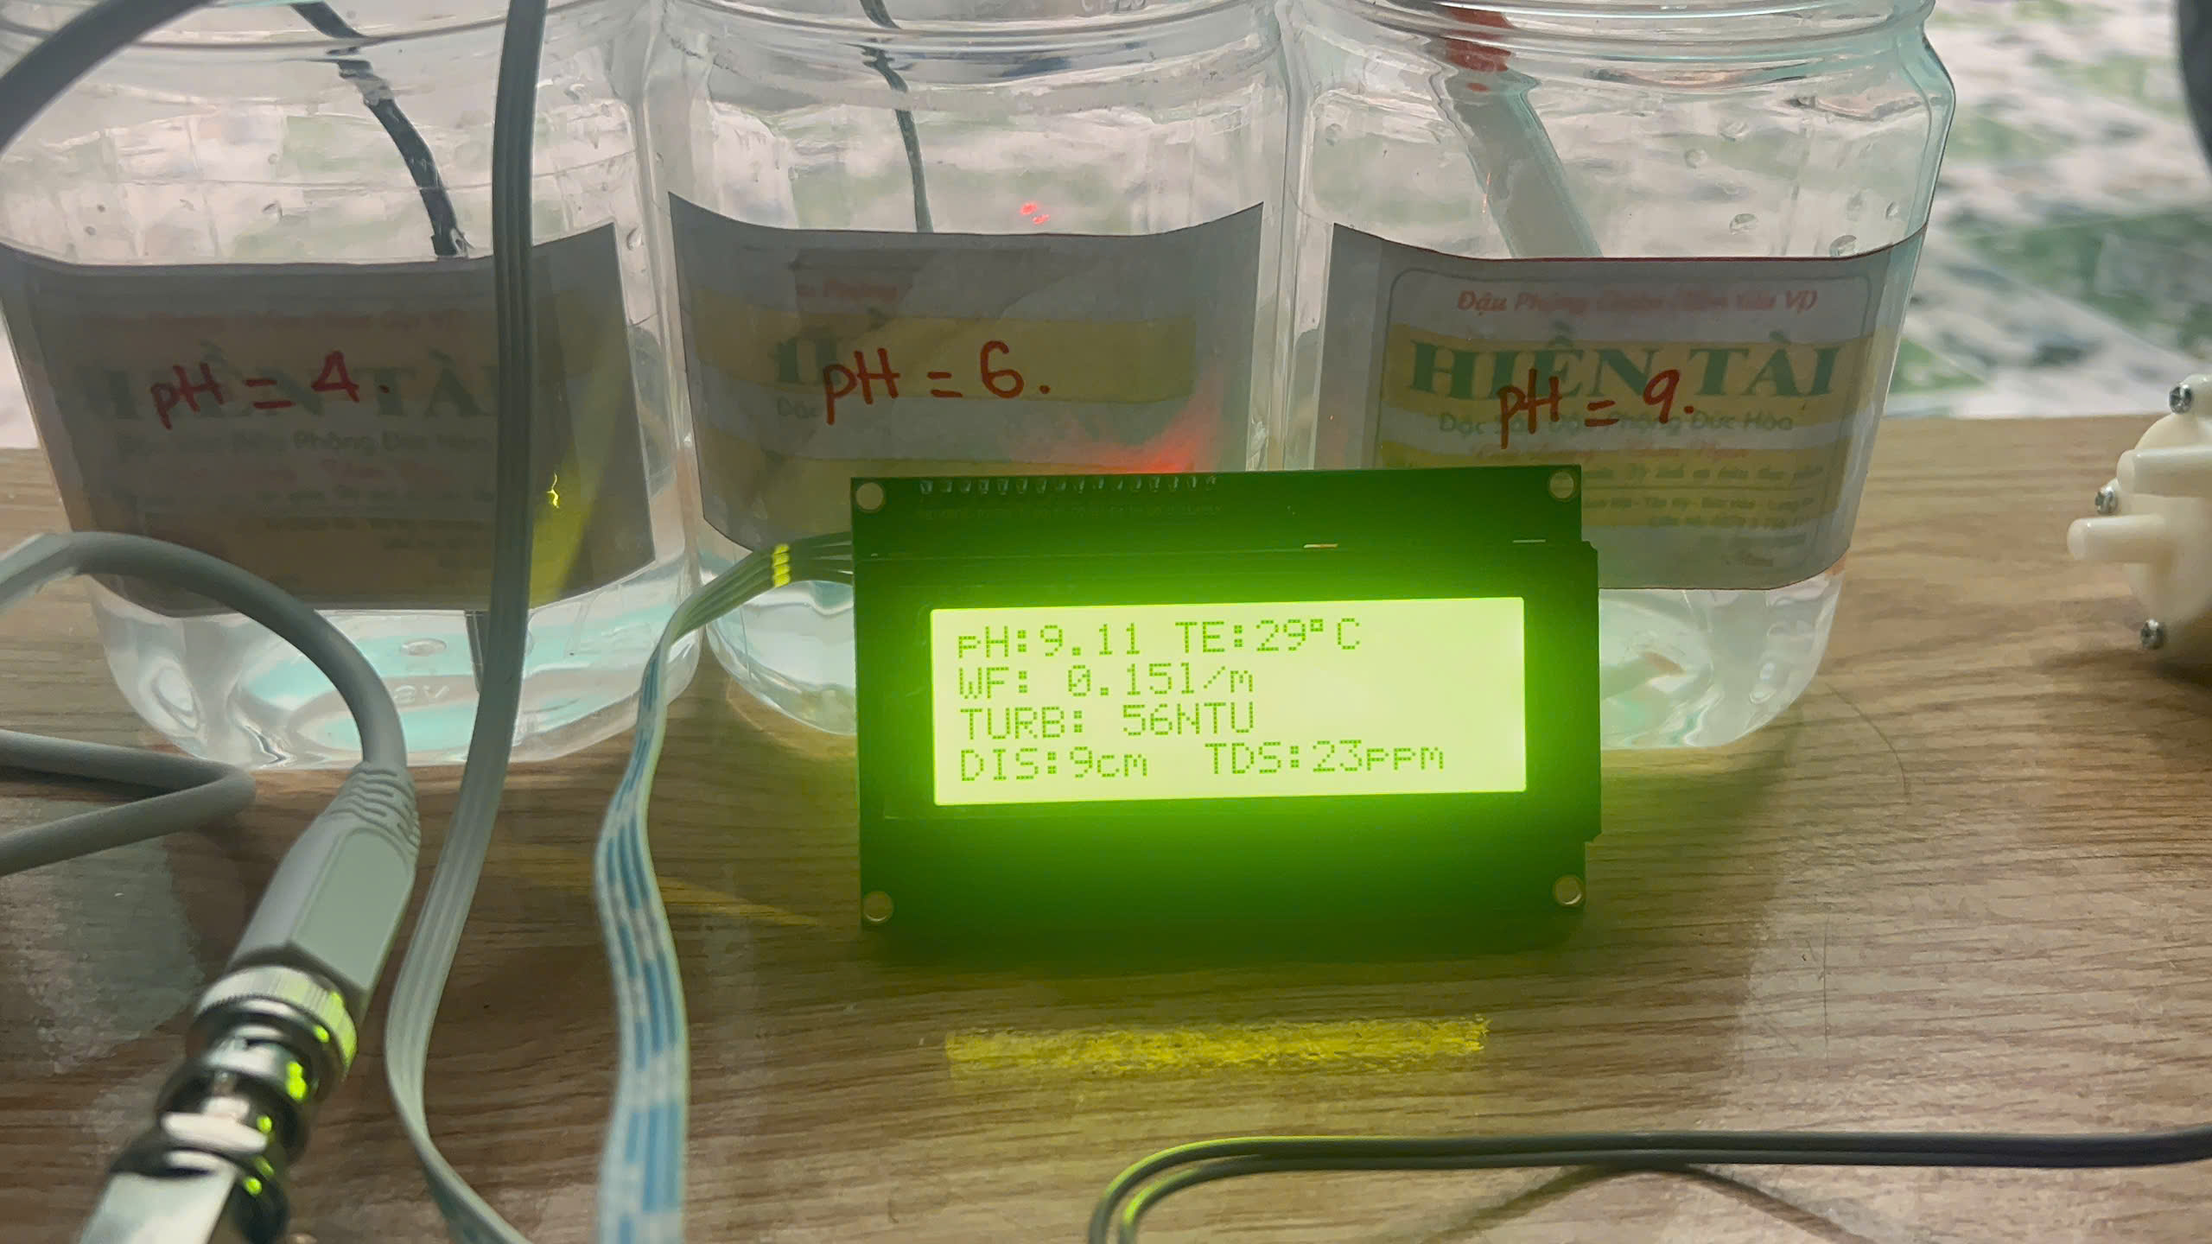
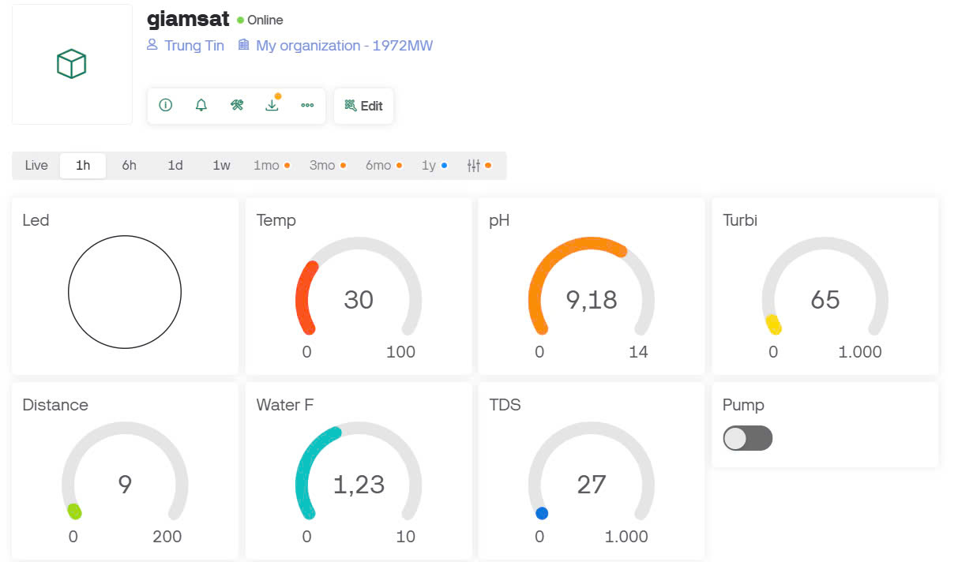
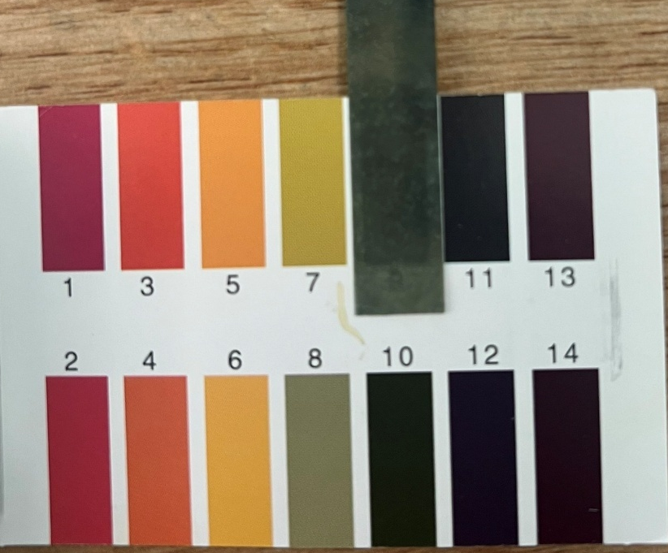
V. Results
3. Evaluate the system performance in different environments.
3.3 Case 3: Alkaline environment: pH about 9.
Figure 5.16 The litmus.
Figure 5.14 Hardware.
Figure 5.15 Blynk.

Slide 19
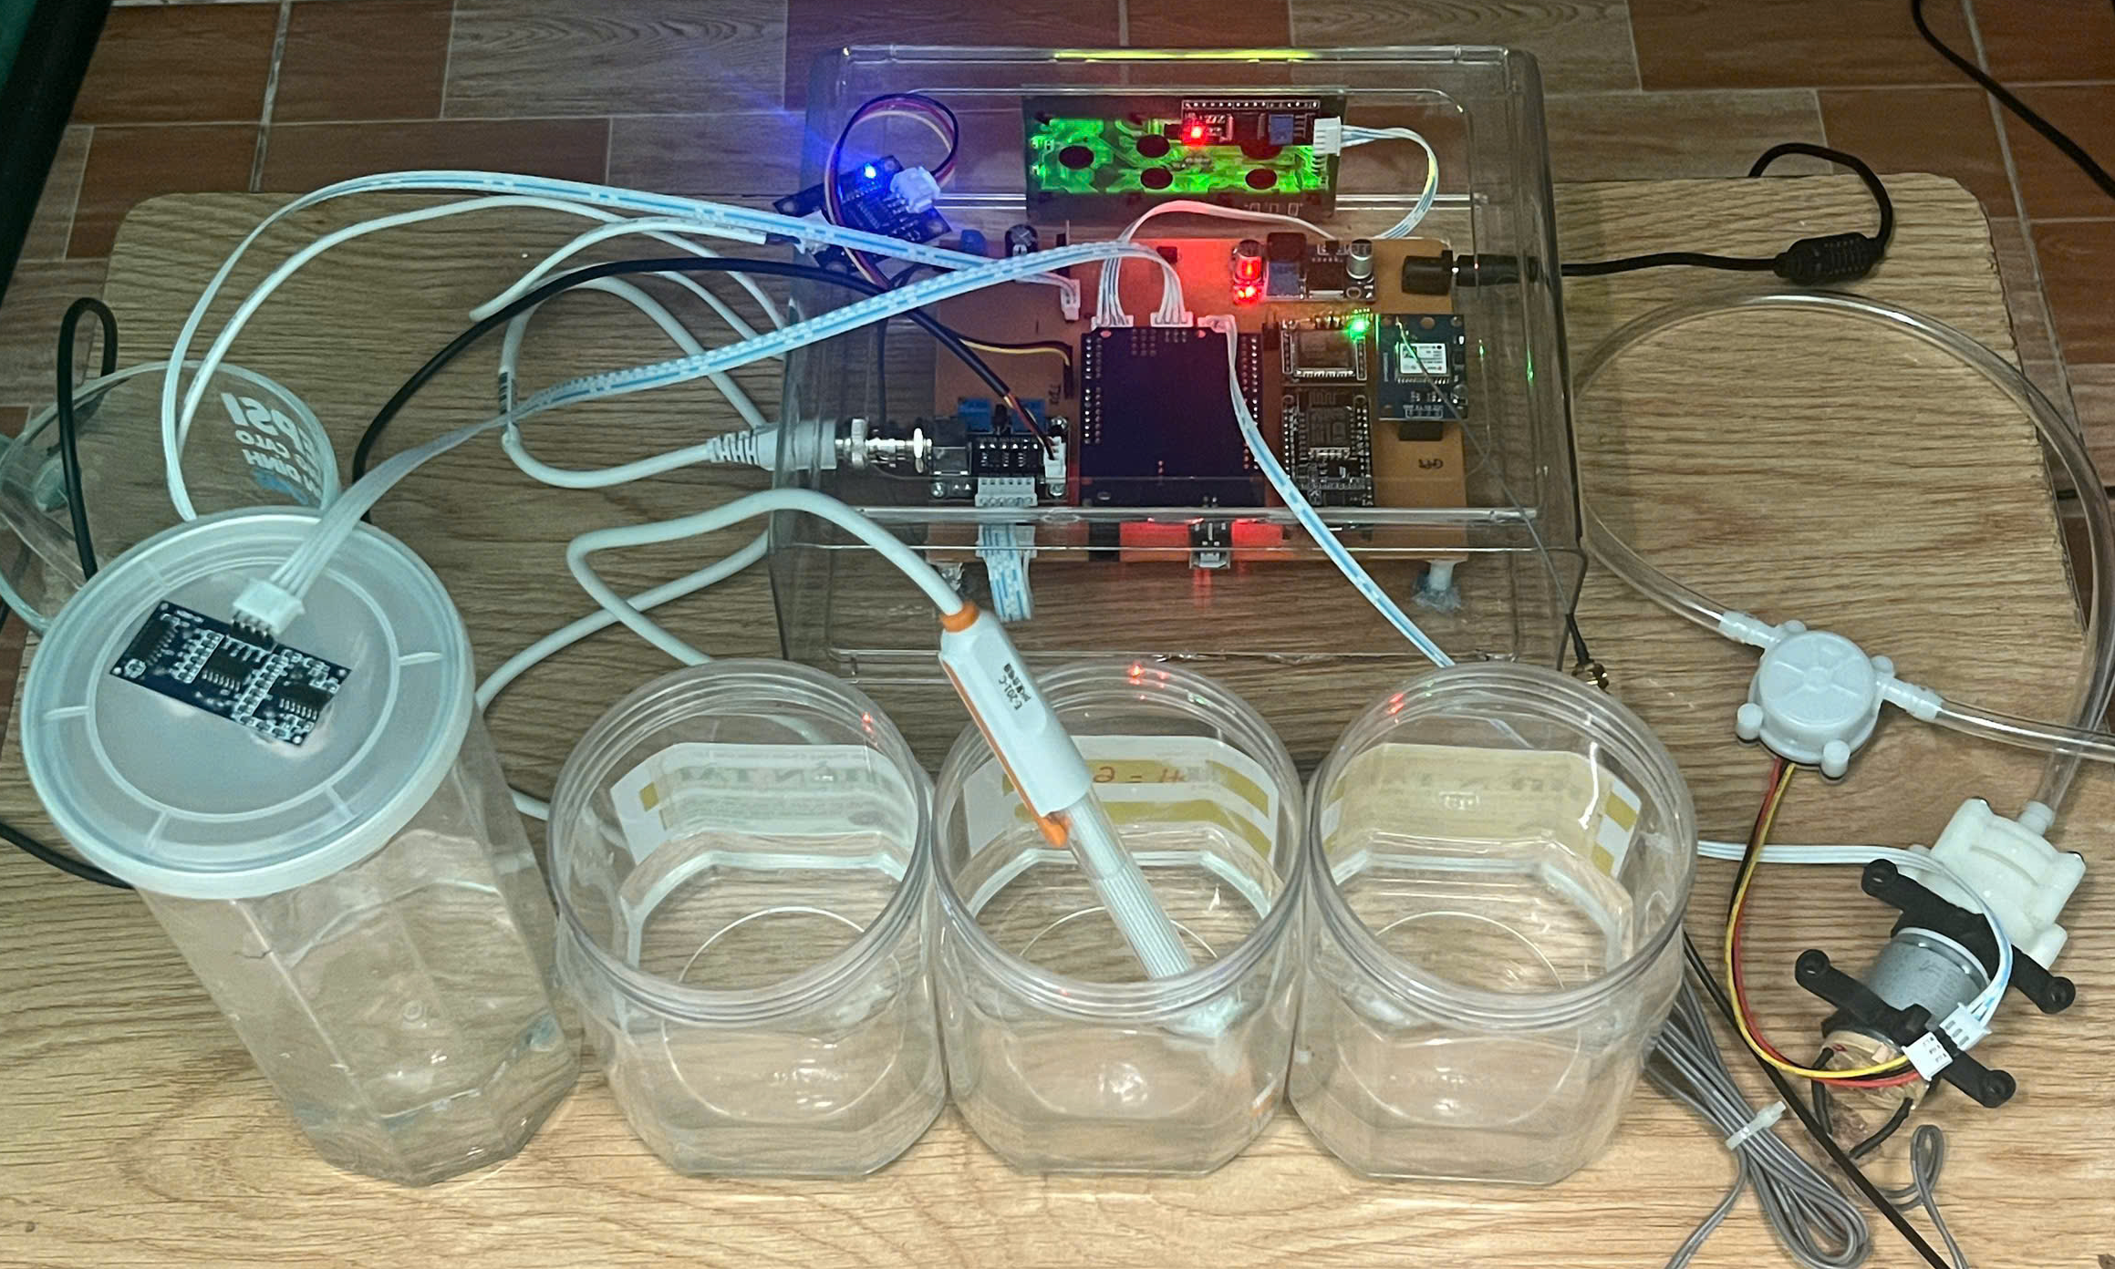
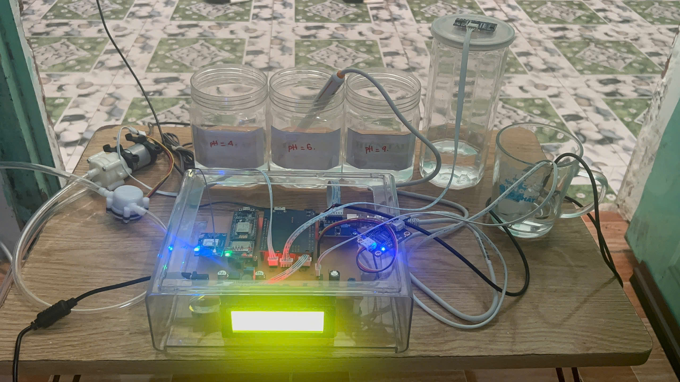
V. Results
4. Set up experiment .
.

Slide 20
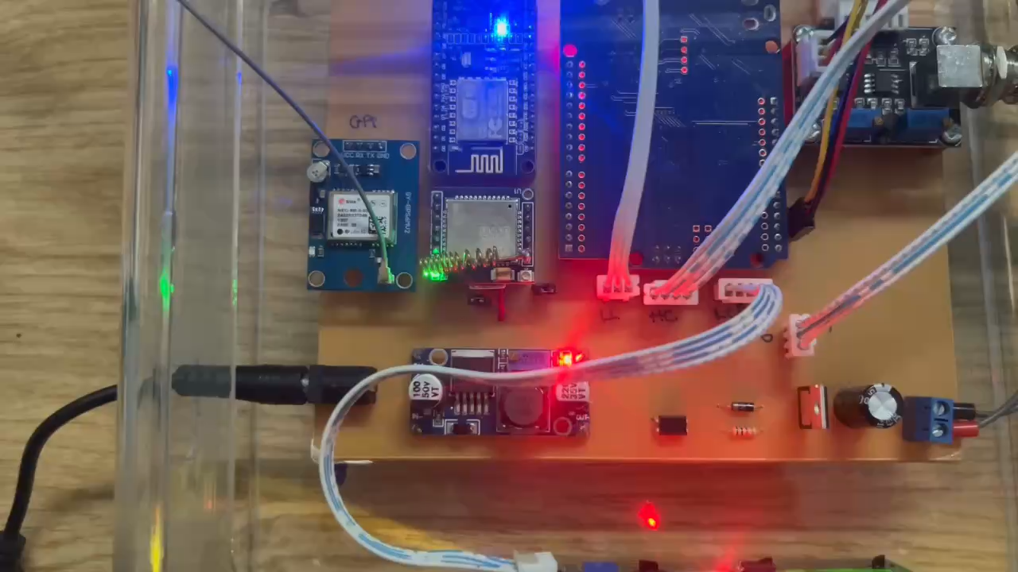
V. Results
5. Evaluate the system performance in different environments.
.

Slide 21
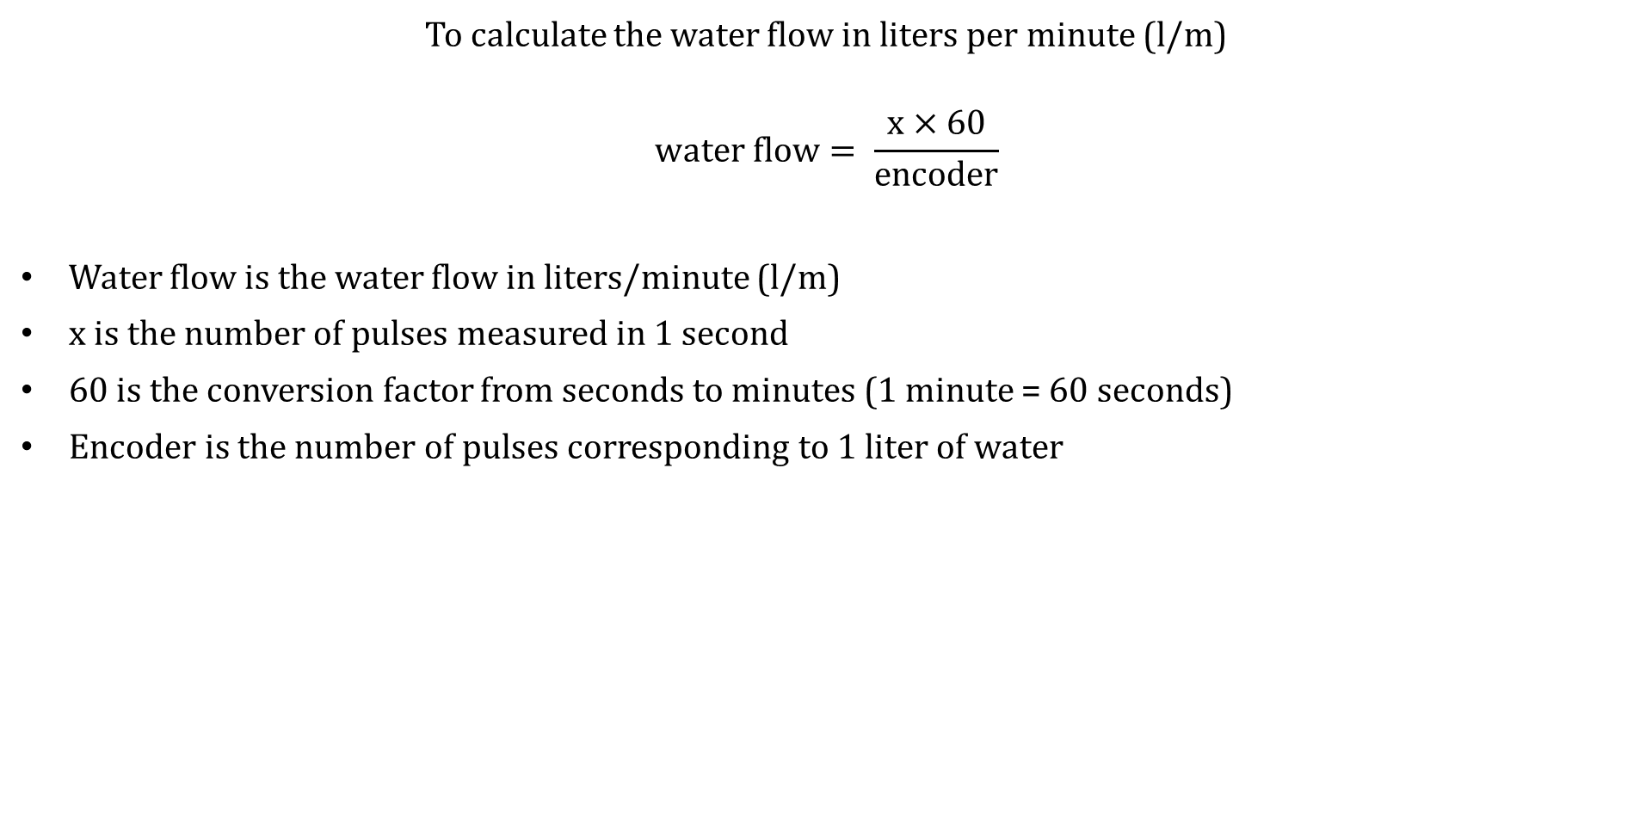
V. Results
5. Flow rate measurement results
To calculate the water flow in liters per minute (l/m)
$$water flow= \frac{x×60}{encoder}$$
Water flow is the water flow in liters/minute (l/m)
x is the number of pulses measured in 1 second
60 is the conversion factor from seconds to minutes (1 minute = 60 seconds)
Encoder is the number of pulses corresponding to 1 liter of water

Slide 22
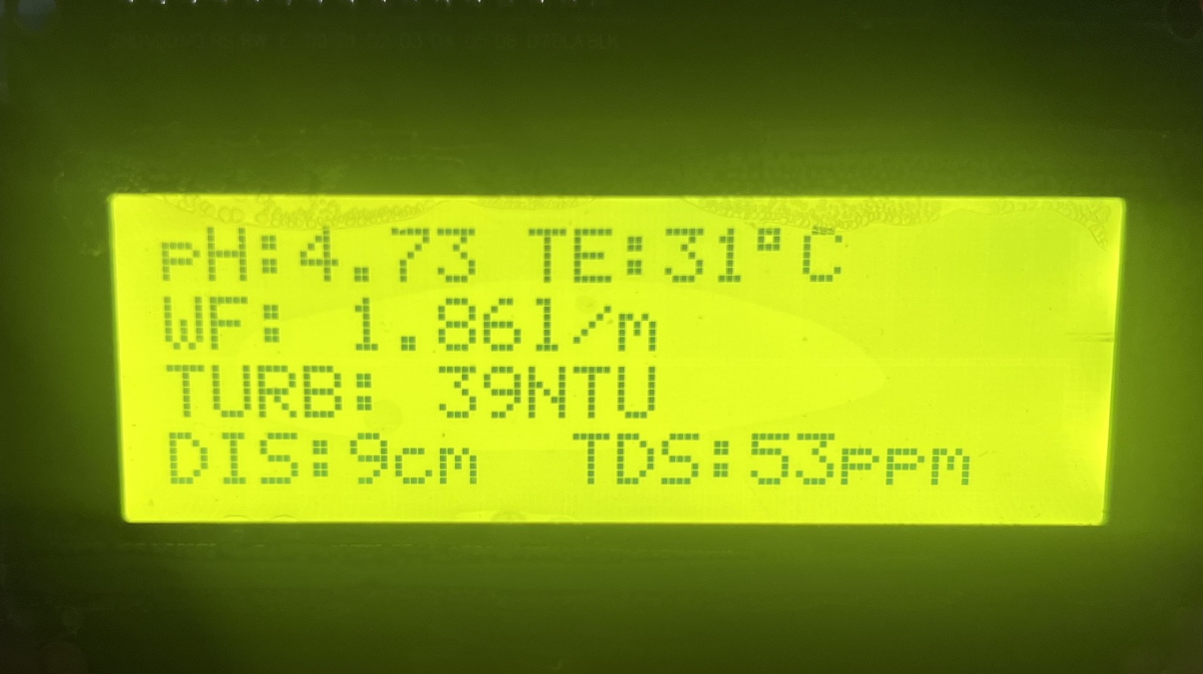
V. Results
5. Flow rate measurement results
385 12VDC pump motor
YF-S401 sensor
8 mm water pipe
2-liter water measuring bottle
Table 5.1 Encoder measurement results
Number of measurements | Pulses/liter results
1 | 2418
2 | 2299
3 | 2398
4 | 2340
5 | 2420
6 | 2425
7 | 2433
8 | 2361
9 | 2381
10 | 2345
AVR encoder | 2382
Figure 5.17 LCD display with WF = 1.86 l/m.

Slide 23
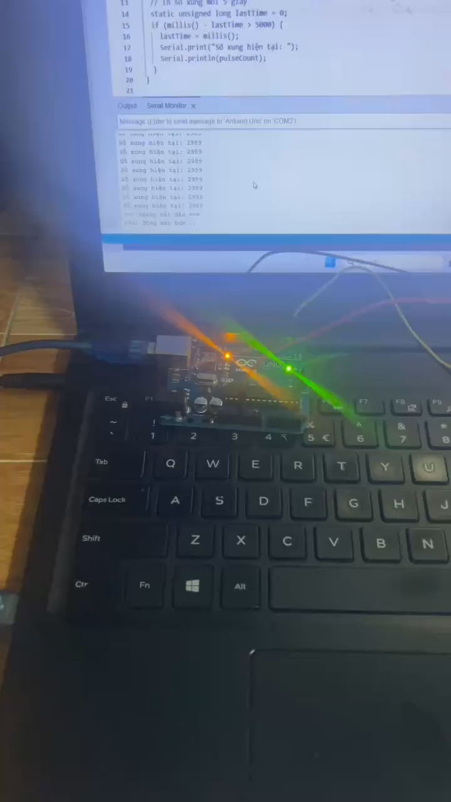
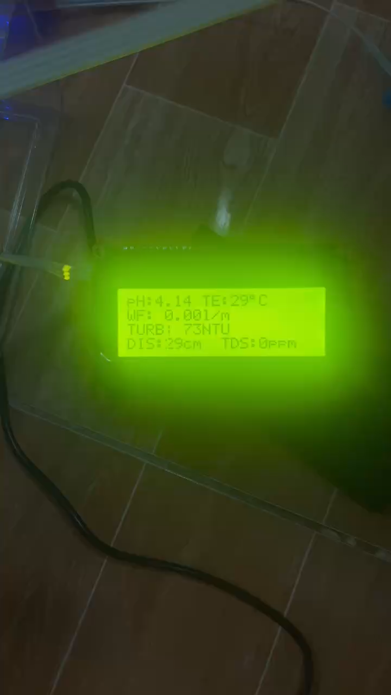
V. Results
5. Flow rate measurement results

Slide 24
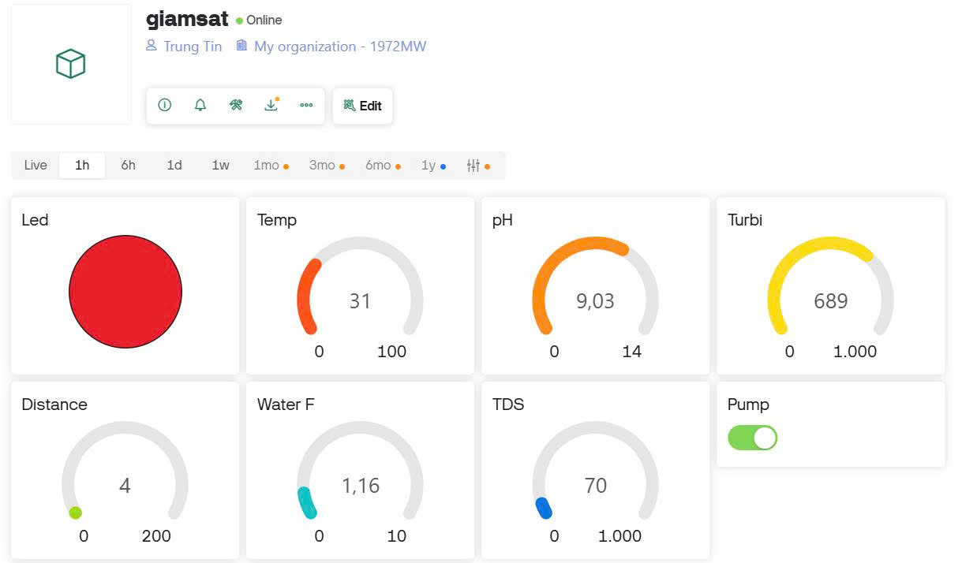
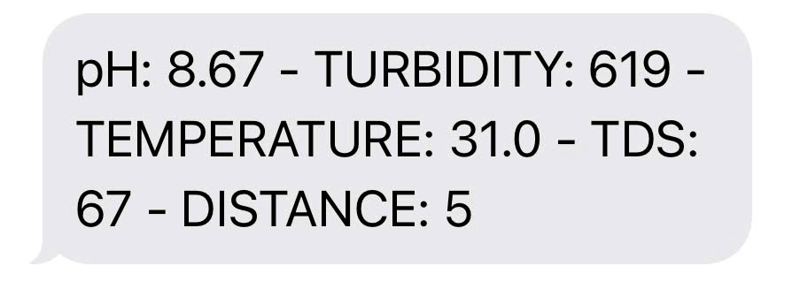
V. Results
5. Warning system test results
5.1 Turbidity warning exceeds 500 NTU
Figure 5.18 Turbidity alert on Blynk.
Figure 5.19 SMS alert with turbidity: 619 NTU.

Slide 25
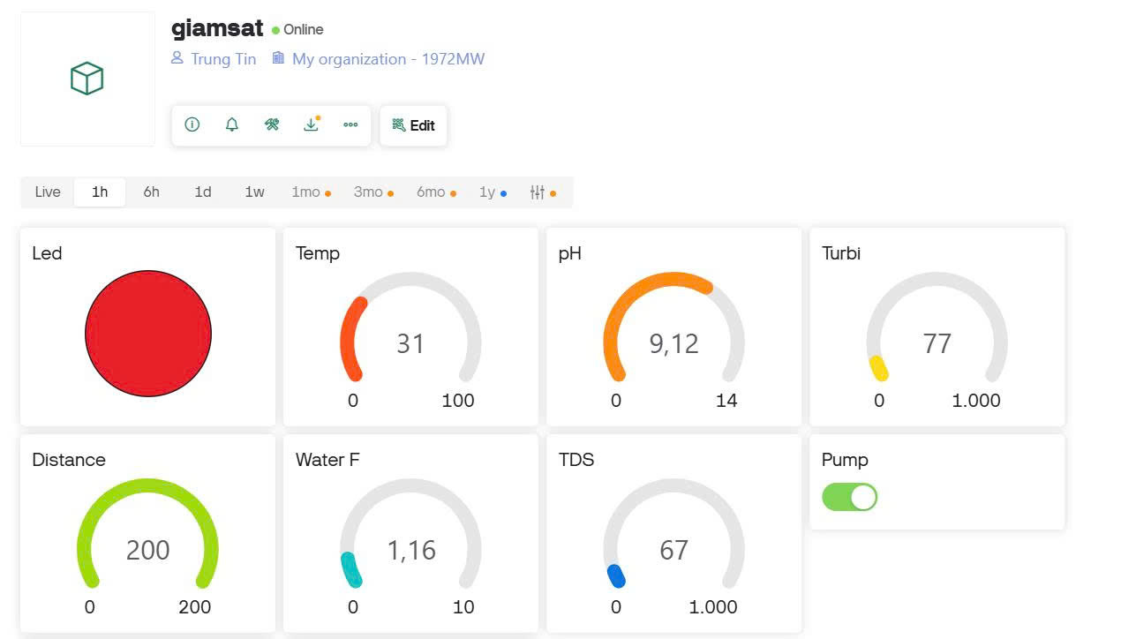
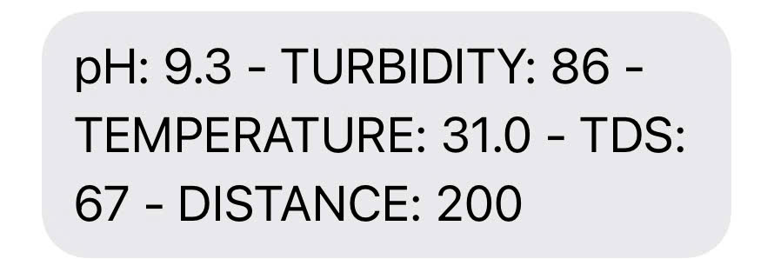
V. Results
5. Warning system test results
5.2 Turbidity warning exceeds 500 NTU
Figure 5.20 Distance alert on Blynk.
Figure 5.21 SMS alert with distance: 200.

Slide 26
Water Quality Parameters Proposed by WHO [5].
Numbers | Parameter | Quality range | Units
1 | pH | 6.5 – 8.5 | pH
2 | Temperature | ≤ 33 | ºC
3 | Turbidity | 0 – 200 | NTU
4 | Total dissolved solids | 0 – 100 | ppm

Slide 27
VI. Conclusion and future work
Conclusion.
I have gained extensive knowledge and practical experience in developing an IoT-based water quality monitoring system
DS18B20 (temperature sensor)
pH sensor
turbidity sensor
Water flow sensor
TDS sensor
ESP8266
4G module
GPS module
Blynk IoT platform

Slide 28
VI. Conclusion and future work
Future work.
Enhance sensor accuracy: improve the stability and precision of pH, turbidity, and TDS sensors
Water classification: system struggles to clearly classify water as clean, polluted, or highly polluted
AI integration: Apply AI-based analytics to predict water quality and generate proactive alerts

Slide 29
VII. References
[1]. https://doctorhouses.com/tam-quan-trong-cua-nuoc-va-giai-phap-cuu-nguon-nuoc-sach.html
[2]. https://vtv.vn/xa-hoi/nguon-nuoc-o-nhiem-co-the-gay-ton-that-toi-35-gdp-moi-nam-20240329195002844.htm
[3]. Kavita Katole, Yashoj Narnaware, Banshikha Biswas, Dimpal Patle, “Design & Implementation of Water Quality Monitoring & Notification
System”, International Research Journal of Engineering and Technology (IRJET), 2019.
[4]. Ogundele Joshua Iyanuoluwa, Steve-Essi Onyiyechi, Francis Idachaba, “Design and Implementation of a Smart Water Monitoring System (IoT) Using Arduino Microcontroller”, College of Engineering, Covenant University, 2022
[5]. Jomsuda Duangwongsa, Thepparath Ungsethaphand, Pradchayaporn Akaboot, Supakit Khamjai, Syan Unankard, “Real-time Water Quality Monitoring and Notification System for Aquaculture”, The 6th International Conference on Digital Arts, Media and Technology (DAMT) and 4th ECTI Northern Section Conference on Electrical, Electronics, Computer and Telecommunications Engineering, 2021

Slide 30
THANK YOU

